Slide 1
Rapport PFE Sur AI ET IOT
NAZIH Youssef & Abdelhak Salaheddine
03/06/2024 UIZ - ESTL

Slide 2
01.
Intelligence artificielle

Slide 3
sommaire
01.
02.
03.
Histoire
Qu’est-ce que l'IA?
Principe fonctionnement de l'IA
04.
05.
06.
Applications de l’ia
avantages
Inconvénients

Slide 4
01.
histoire

Slide 5
histoire
Les débuts de l'IA (1950-1980)
L'essor et les défis (1980-2000)
L'ère de l'IA moderne (2000 à aujourd'hui)

Slide 6
02.
Qu’est-ce que l'IA?

Slide 7
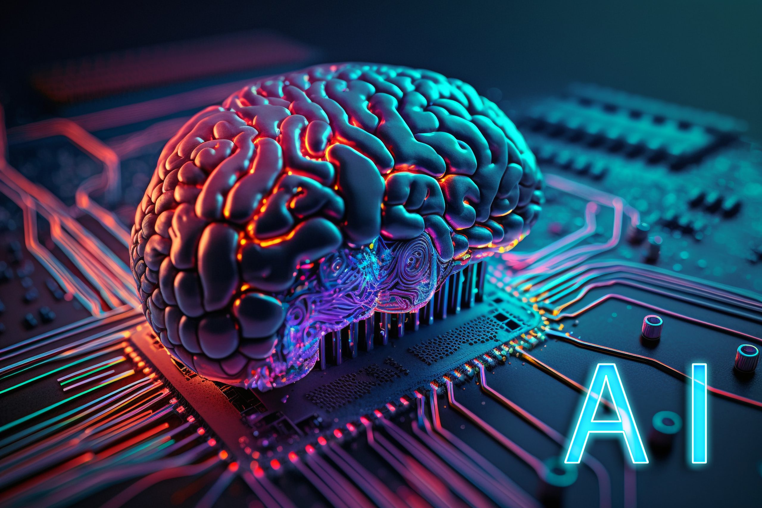
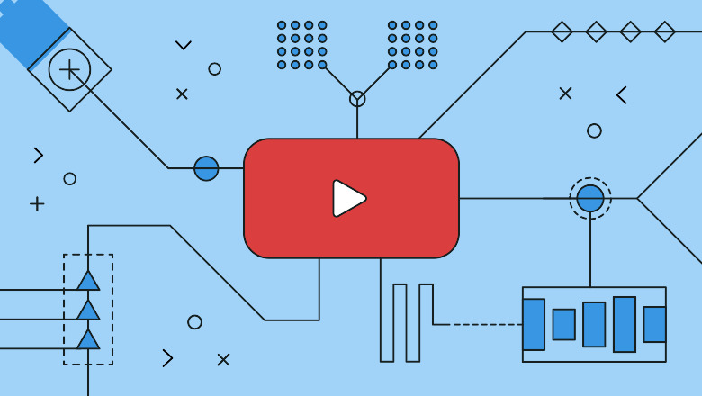
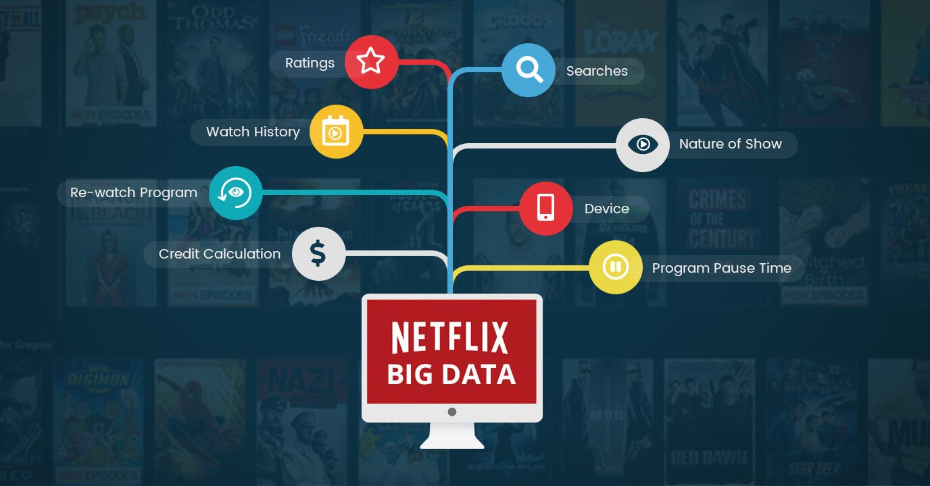

Slide 8
03.
Principe fonctionnement de l’ia

Slide 9
Principe fonctionnement
Collection de données
Traitement de données
Etapes finales
entrainement
En utilisant des sites our livres…
Absorber les données
Repetition
Apprentissage automatique

Slide 10
04.
Applications de l’ia

Slide 11
Application de l’ia
divertissement
education
creatif
Netflix, TikTok, YouTube…
ChatGPT, Gemini, Wolfram Alpha…
Gemini Vision, GPT-4, Dalle-2

Slide 12
05.
Avantages de l’ia

Slide 13
avantages de l’ia
scientifique
santé
creatif
Calcules complexes et predictions
Diagnostique et utilité chimique
Correction et géneration de materiel

Slide 14
06.
Inconvéniants de l’ia

Slide 15
inconveniants de l’ia
Violation de vie privé
biais
tricher
Ex: IA générative avec images personelles
Ex: Situations politiques
Ex: Examens ou jeux

Slide 16
01.
Systeme de gestion de dechets

Slide 17
Sommaire
01.
02.
03.
Etat de l’art
Objectifs visés
Methodologie adoptée
04.
05.
06.
Sélection de composants
Programmation
Présentation de résultats et testing

Slide 18
01.
Etat de l’art

Slide 19
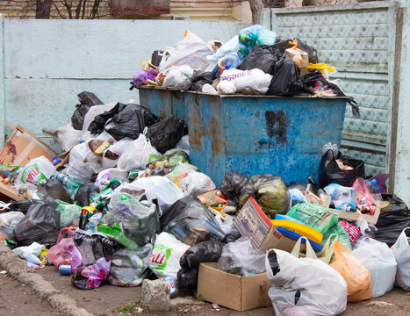

Slide 20
PROBLEM VS. SOLUTION
Gratuit avec beaucoup de problèmes
System normal
25DH, simple et efficace
System 25dh

Slide 21
02.
Objectifs visés

Slide 22
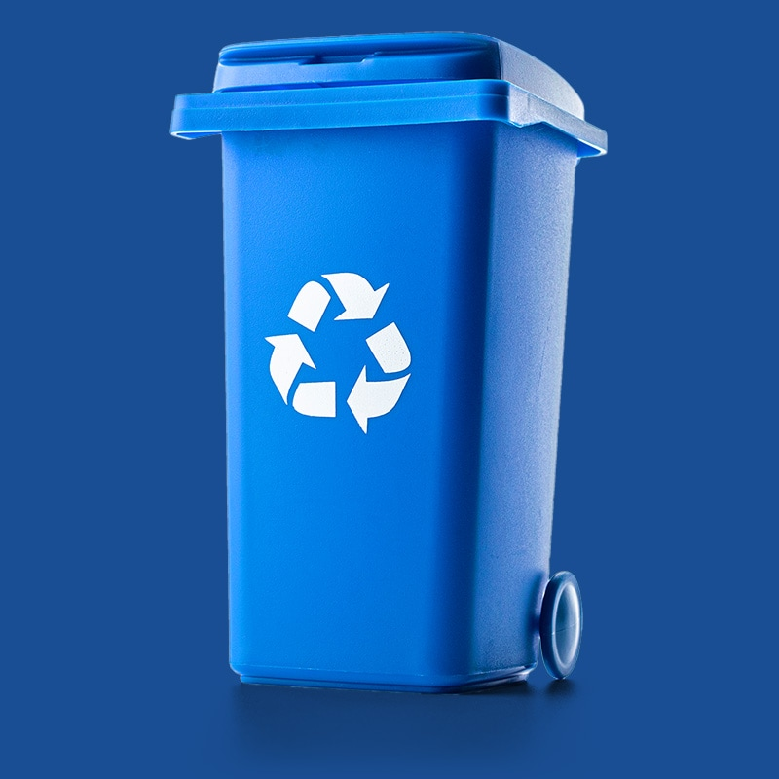
objectifs
Améliorer l'efficacité de la collecte des déchets.
Réduire le nombre d'ordures envoyées en décharge en encourageant le recyclage
Améliorer la qualité de vie des résidents
Sensibiliser la population à l'importance de la gestion des déchets

Slide 23
03.
Methodologie adoptée

Slide 24
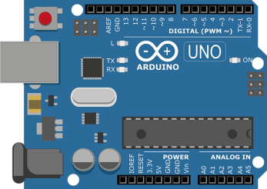
methodologie
L'utilisation de l'Arduino UNO, d'un écran LCD, d'un capteur ultrasonique et d'un module Ethernet pour détecter les niveaux de déchets tout en les affichant localement et à distance.

Slide 25
04.
Selection de composants

Slide 26
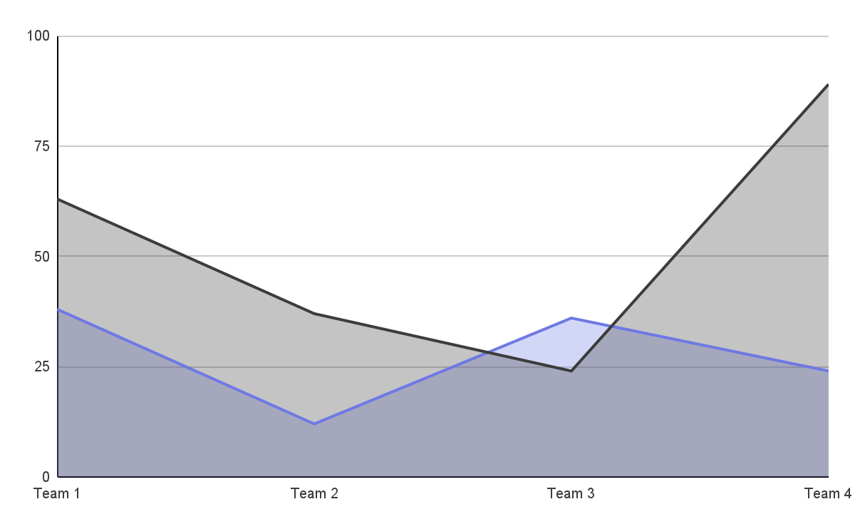
MARKET TRENDS
Periode 1
Mercury is the closest planet to the Sun
Periode 2
Venus is the second planet from the Sun
Follow the link in the graph to modify its data and then paste the new one here. For more info, click here

Slide 27


THEM
US
Mercury is the closest planet to the Sun and the smallest one in the Solar System—it’s only a bit larger than the Moon
Venus has a beautiful name and is the second planet from the Sun. It’s hot and has a poisonous atmosphere

Slide 28
02.
MARKET ANALYSIS AND COMPETITION
You can enter a subtitle here if you need it

Slide 29
TARGET
65%
35%
€1,500/year
Gender
AVERAGE SPEND
+60
mercury
+50
jupiter
+40
venus
AGE
PROFESSION

Slide 30
Market size
VENUS
Venus is the second planet from the Sun
MERCURY
It’s the closest planet to the Sun

Slide 31
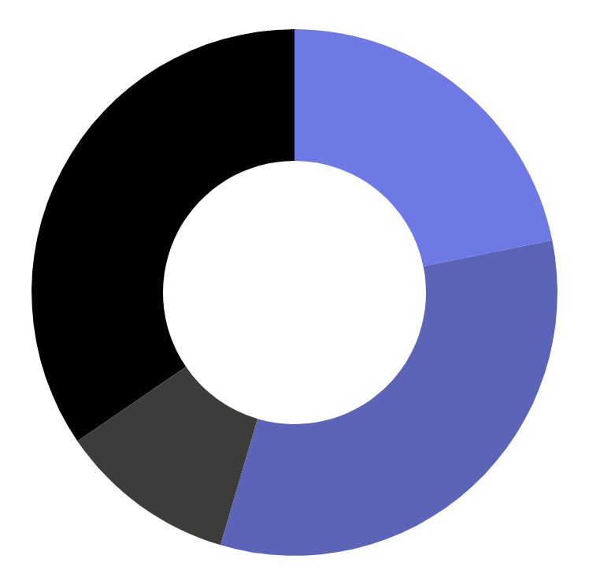
MARKET SHARE
24%
Mercury is the closest planet to the Sun
36%
Venus is the second planet from the Sun
12%
Mars is actually a very cold place
38%
Jupiter is the biggest planet of them all
Follow the link in the graph to modify its data and then paste the new one here. For more info, click here

Slide 32
COMPETITION ANALYSIS
 | COMPANY 1 | COMPANY 2 | COMPANY 3 | COMPANY 4
JUPITER
SATURN
NEPTUNE

Slide 33
03.
SALES AND MARKETING PLAN
You can enter a subtitle here if you need it

Slide 34
OUR SERVICES
mercury
venus
mars
jupiter
saturn
neptune
Mercury is the closest planet to the Sun
Venus has a beautiful name, but it’s terribly hot
Despite being red, Mars is a cold place, not hot
It’s the biggest planet in the Solar System
Saturn is the ringed planet and a gas giant
It’s the farthest planet from the Sun

Slide 35
BREAK-EVEN ANALYSIS
LOSS
PROFIT
Jupiter is the biggest planet of them all
Venus is the second planet from the Sun
BIG LOSS
BREAK-EVEN POINT
HIGH PROFIT
Mercury is the closest planet to the Sun
Mars is actually a very cold place
Earth is the beautiful planet we live on

Slide 36
AWESOME WORDS

Slide 37
OUR PLANS
BASIC
PRO
PREMIUM
€35
€50
€85
Mercury is the closest planet to the Sun and the smallest one
Saturn is a gas giant, composed mostly of hydrogen and helium
Jupiter is a gas giant and the biggest planet in the Solar System

Slide 38
ADVERTISING AND PROMOTION
MERCURY
VENUS
MARS
Mercury is the closest planet to the Sun
Venus has a beautiful name, but it’s terribly hot
Despite being red, Mars is a cold place, not hot

Slide 39
04.
MANAGEMENT PLAN
You can enter a subtitle here if you need it

Slide 40


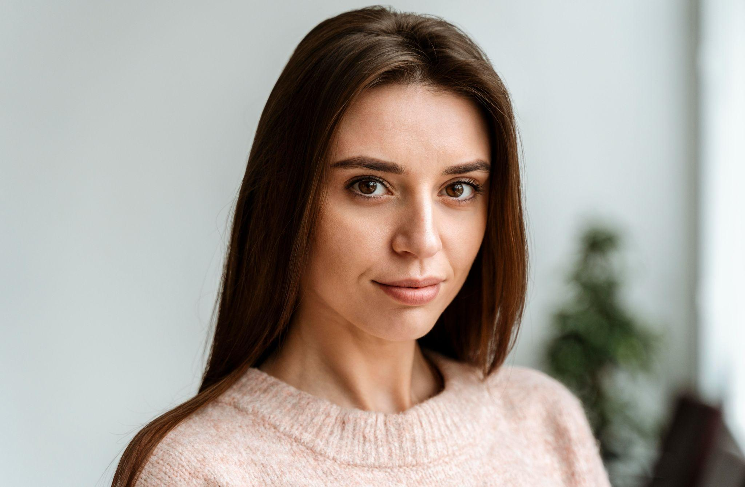
OUR TEAM
JENNA DOE
TIMMY JIMMY
SUSAN BONES
You can speak a bit about this person here
You can speak a bit about this person here
You can speak a bit about this person here

Slide 41
ORGANIZATIONAL CHART
composants
hardware
software
Arduino uno
lcd
Hc-sr04
employee
employee

Slide 42
OUR PARTNERS
PARTNER 1
Mercury is the closest planet to the Sun
PARTNER 2
Venus is the second planet from the Sun
PARTNER 3
Mars is actually a very cold place
PARTNER 4
Jupiter is the biggest planet of them all

Slide 43
05.
OPERATING PLAN
You can enter a subtitle here if you need it

Slide 44
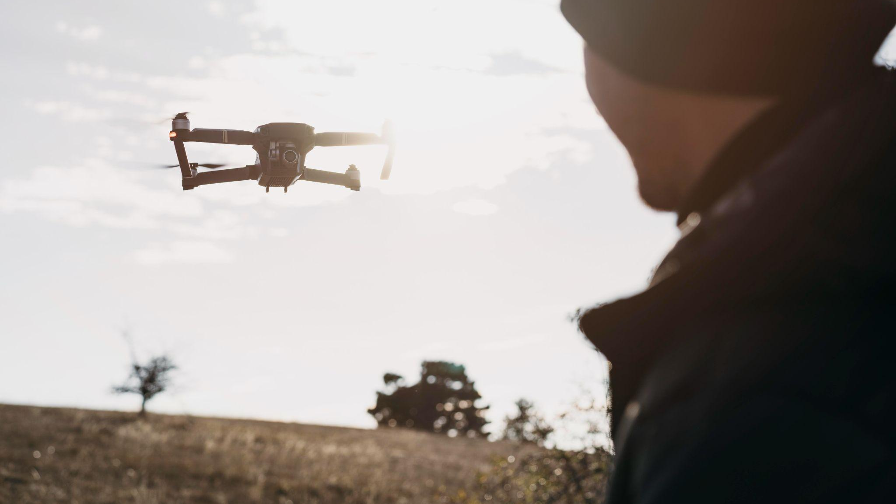
A PICTURE ALWAYS REINFORCES THE CONCEPT

Slide 45
OUR PROCESS
DAY 1
DAY 3
DAY 5
Earth is the planet we all live on
Despite being red, Mars is a cold place
Saturn is a gas giant and has several rings
DAY 2
DAY 4
Venus is the second planet from the Sun
Jupiter is the biggest planet of them all

Slide 46
06.
FINANCIAL PLAN
You can enter a subtitle here if you need it

Slide 47
$150,000
Big numbers catch your audience’s attention

Slide 48
—SOMEONE FAMOUS
“This is a quote, words full of wisdom that someone important said and can make the reader get inspired.”

Slide 49
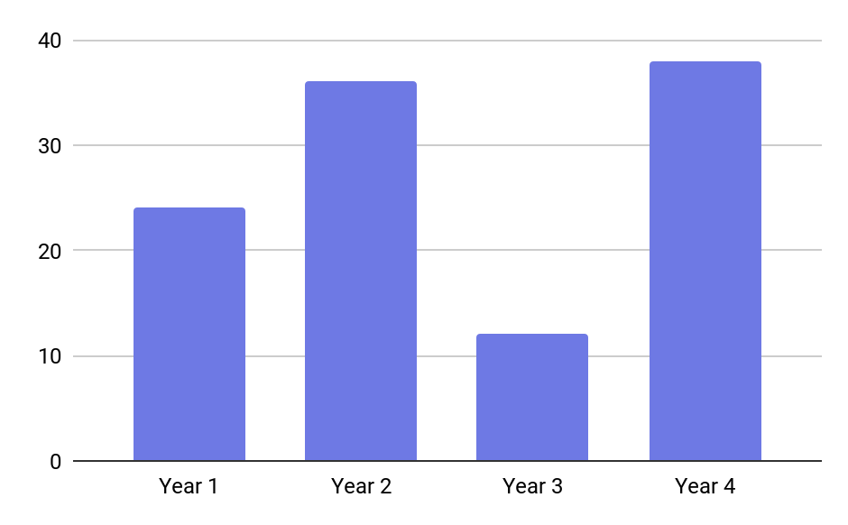
PREDICTED GROWTH
MERCURY
It’s the closest planet to the Sun and the smallest one in the Solar System. This planet's name has nothing to do with the liquid metal, since Mercury was named after the Roman messenger god
Follow the link in the graph to modify its data and then paste the new one here. For more info, click here

Slide 50
BALANCE SHEET
assets
liabilities
equity
3,5M
1k
7k
What the company owns by itself
What the company owes to others
The difference between both

Slide 51
THANKS
Do you have any questions?
youremail@freepik.com
+91 620 421 838
yourcompany.com
Please keep this slide for attribution

Slide 52
Fonts & colors used
This presentation has been made using the following fonts:
Bebas Neue
(https://fonts.google.com/specimen/Bebas+Neue)
Raleway
(https://fonts.google.com/specimen/Raleway)
#000000
#ffffff
#3c3c3b
#c1c1c1
#e7e7e7
#6e79e4
#5c64b8

Slide 53
...and our sets of editable icons
You can resize these icons without losing quality.
You can change the stroke and fill color; just select the icon and click on the paint bucket/pen.
In Google Slides, you can also use Flaticon’s extension, allowing you to customize and add even more icons.

Slide 54
Educational Icons
Medical Icons

Slide 55
Business Icons
Teamwork Icons

Slide 56
Help & Support Icons
Avatar Icons

Slide 57
Creative Process Icons
Performing Arts Icons

Slide 58
Nature Icons

Slide 59
SEO & Marketing Icons

